Slide 1


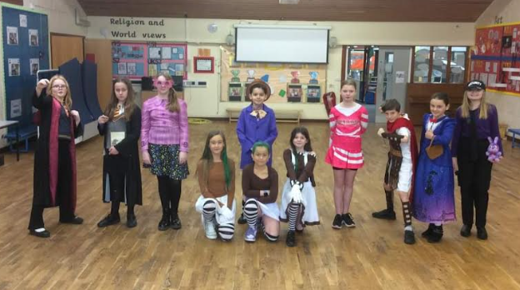
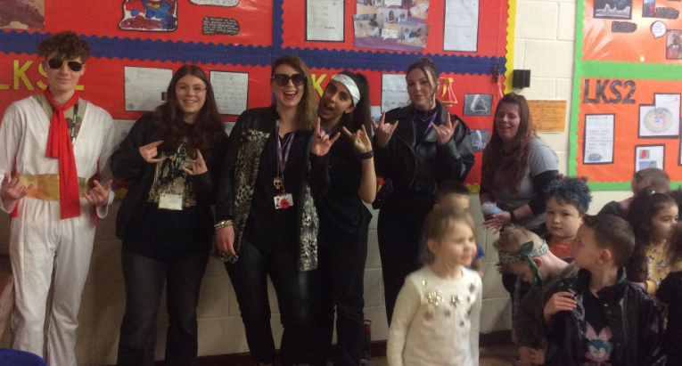

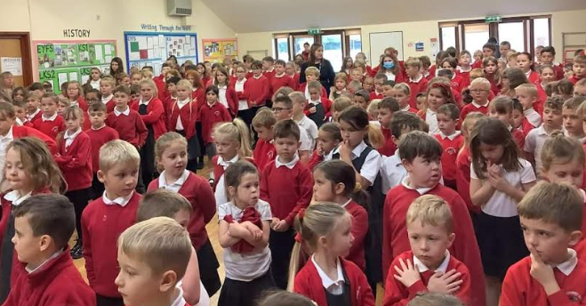

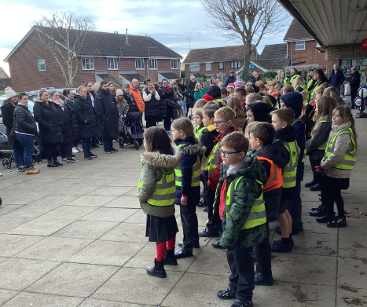
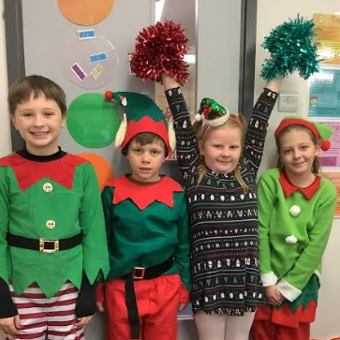



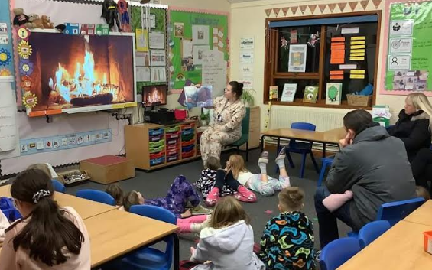
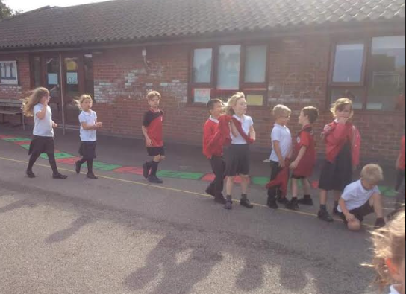
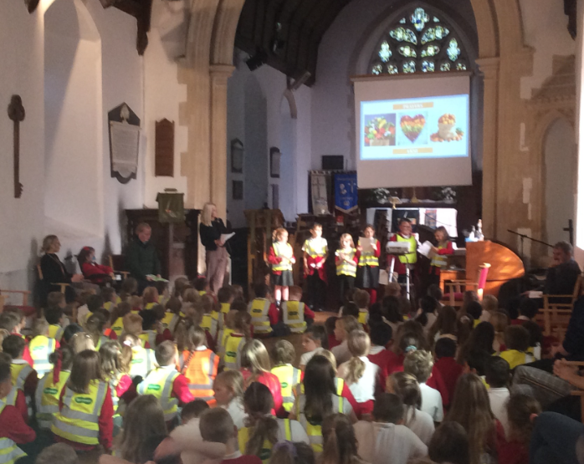
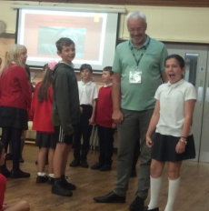

YEAR 7 ENGLISH
Grove Primary School
Cycle B
First Light Festival
Sports Day
Sports for Sports Event
Summer 2
Silly Science Day
Summer 1
Blue Day
Water Aid
Author visit
James Campbell
Word Book Day
Rock choir
Rockstar Day
Spring 2
Rock choir
Big Bird Watch
Remembrance Day Assembly
Children in Need
Christmas carols
at the Co-Op
Elf Day
Silly Sock Day
Anti-bullying
Spring 1
Junk
modelling club
Bed Time Stories
Christmas Service
Rock choir
Halloween Disco
Great Ormond Street 5k
Harvest Festival
Rock choir
Autumn 2
Autumn 1
Author visit
Steve Clifford
World Mental Health Day
WHOLE SCHOOL ENRICHMENT JOURNEY

